Slide 1
Pong-Inertial: an unusual game
The BIPOLES
Benjamin Coull-Neveu, Franco Del Balso, Piotr Jakuc, Sandhya Rottoo
U2 physics

Slide 2
A pong table might seem quite sound But beware, as it starts to go ‘round The forces, fictitious Can be quite pernicious Your ball might end up on the ground
In a rotating reference frame, fictitious forces arise, and they don’t seem to have a physical origin
$$F_{fictitious}=−mω\left(ω×r\right)−2mω×v −m\dot{ω}×r$$
Centrifugal
Coriolis
Azimuthal

Slide 3
A rotating reference frame?????
Some guy, probably: Why would you make a game of pong in a rotating reference frame? That’s so much harder and more annoying. It’s so counter-intuitive to predict the motion of the ball!
Us: Erm, actchully…you’re right.
Some other guy: Who even cares about classical mechanics? Quantum and relativity are so much cooler.
Us: Erm, ackschully…you’re WRONG.
Here’s why rotating reference frames are super cool.

Slide 4
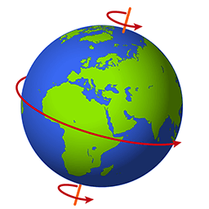
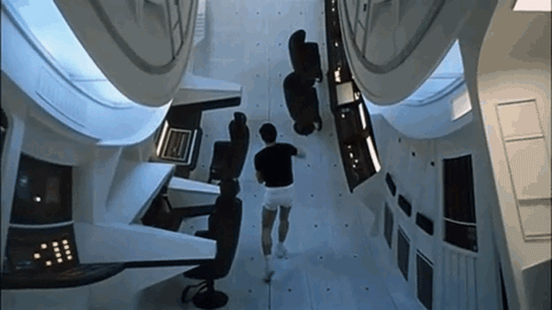
A rotating reference frame?????

Slide 5
What did we do?
Two players are constrained to glide around the rim of a rotating disk
Since they are rotating with the disk, they see the ball being accelerated in odd ways
First one to miss their hit loses
Power-ups appear along the track

Slide 6
How did we do it?
Pygame is a python-based game development software which allows us to draw objects that can be moved, created and deleted

Slide 7



Takeaways
Classical mechanics can be just as cool and weird as QM or relativity
Physics is easy, coding is hard
We had a lot of fun making and playing this game, and we hope you will too.
The real non-inertial reference frame is the friends we made along the way

